Slide 1
My name is Lillian Botsford-Rhodes and in May of 2020 I created a survey about teen mental health. I sent the survey link out through social media and asked all my friends (ages 13-18 year old) to fill it out. These are the survey results.
TEEN MENTAL HEALTH SURVEY RESULTS
MAY 2020 - WASHTENAW COUNTY, MICHIGAN

Slide 2
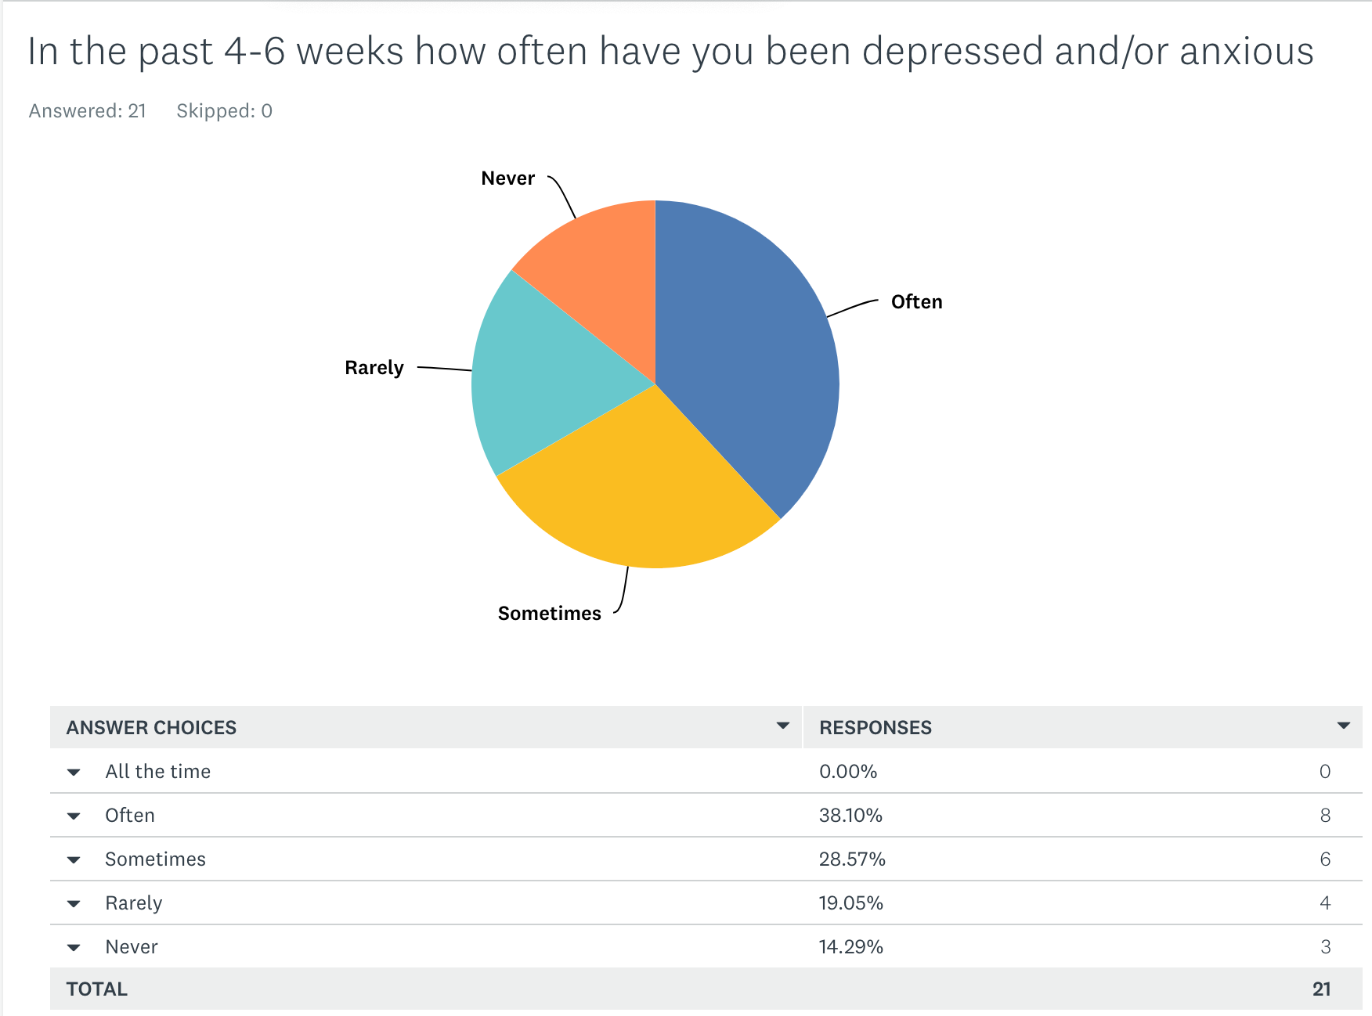

Slide 3
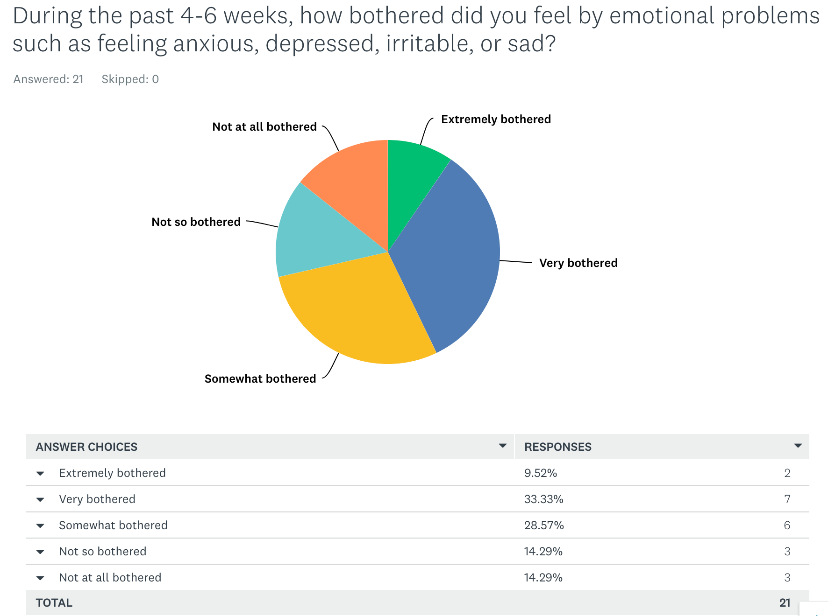

Slide 4
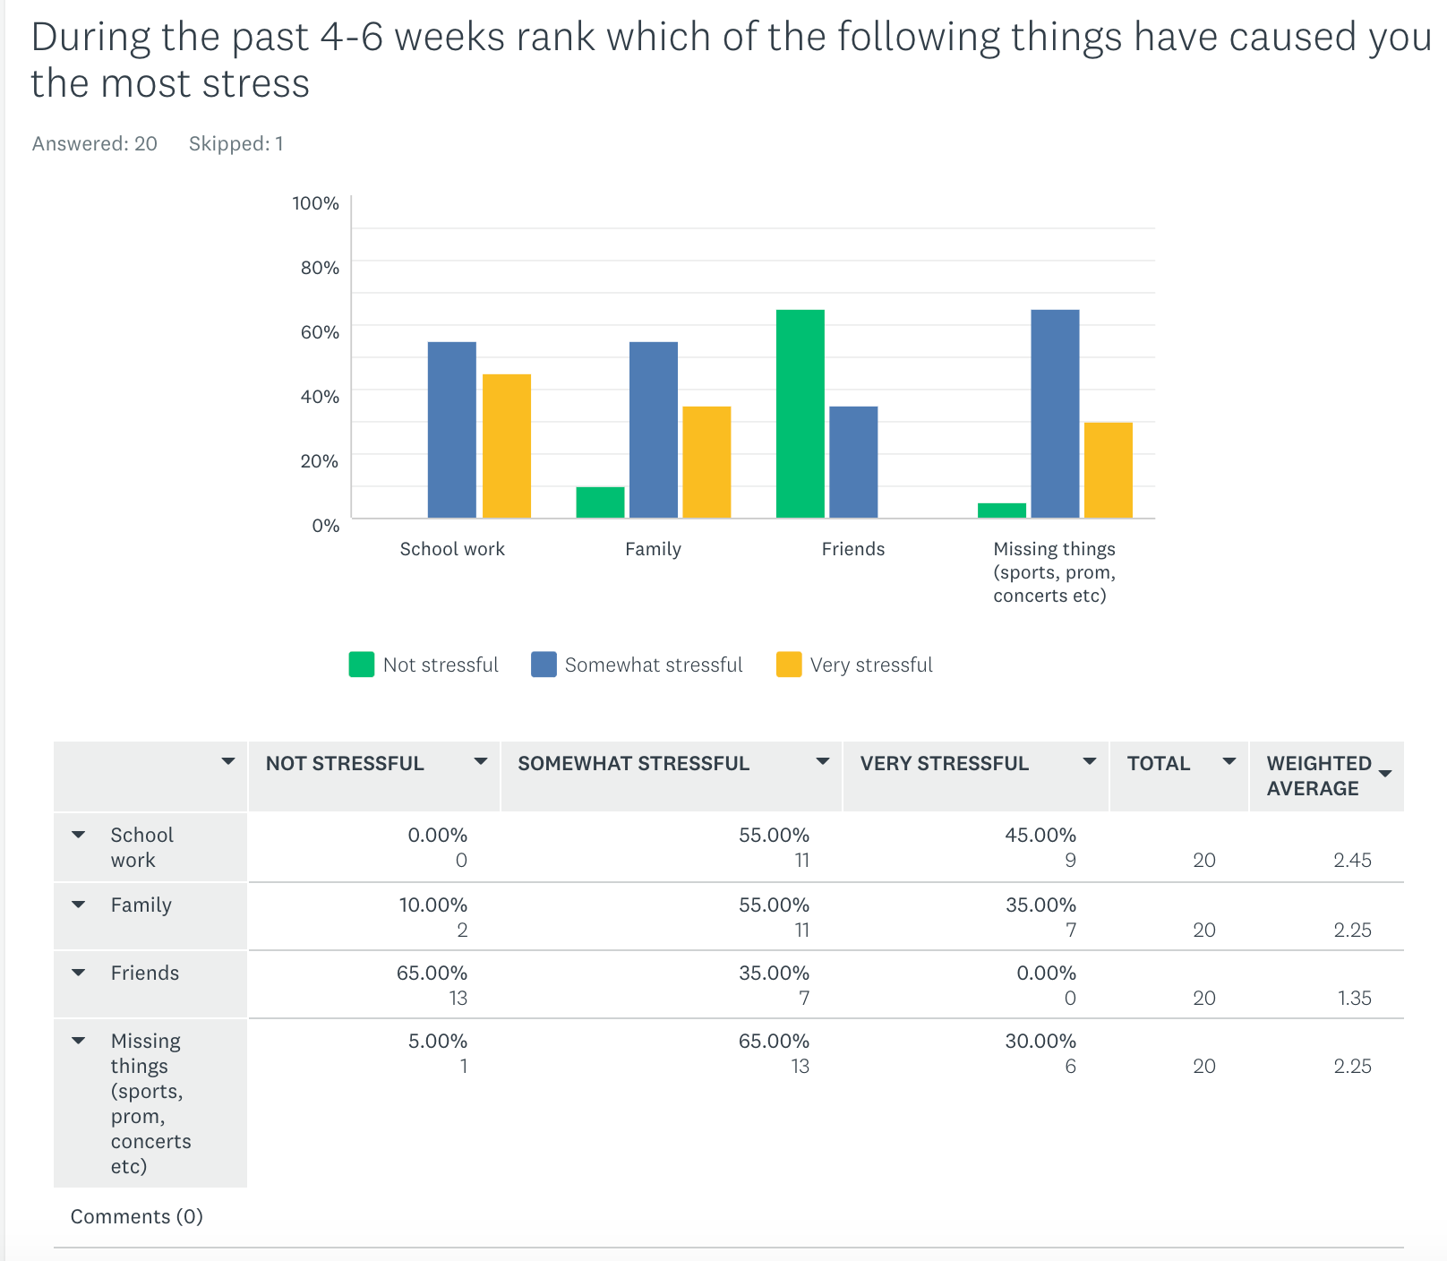

Slide 5
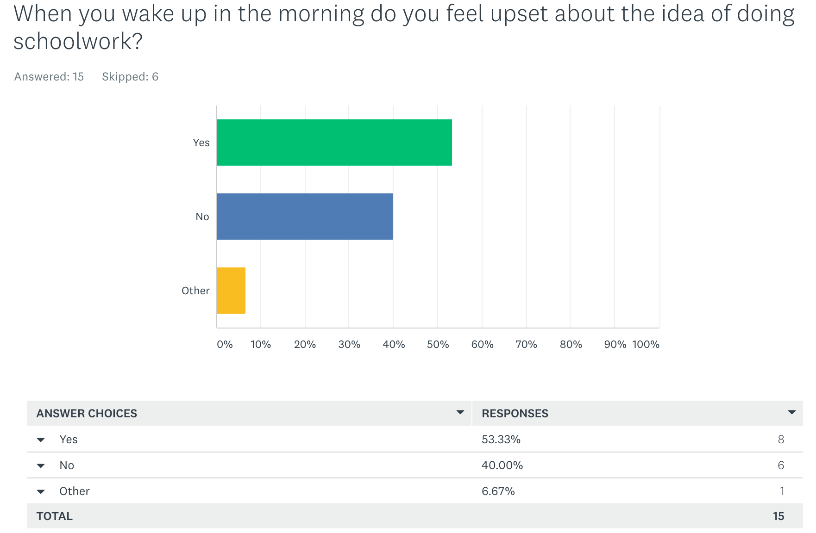

Slide 6
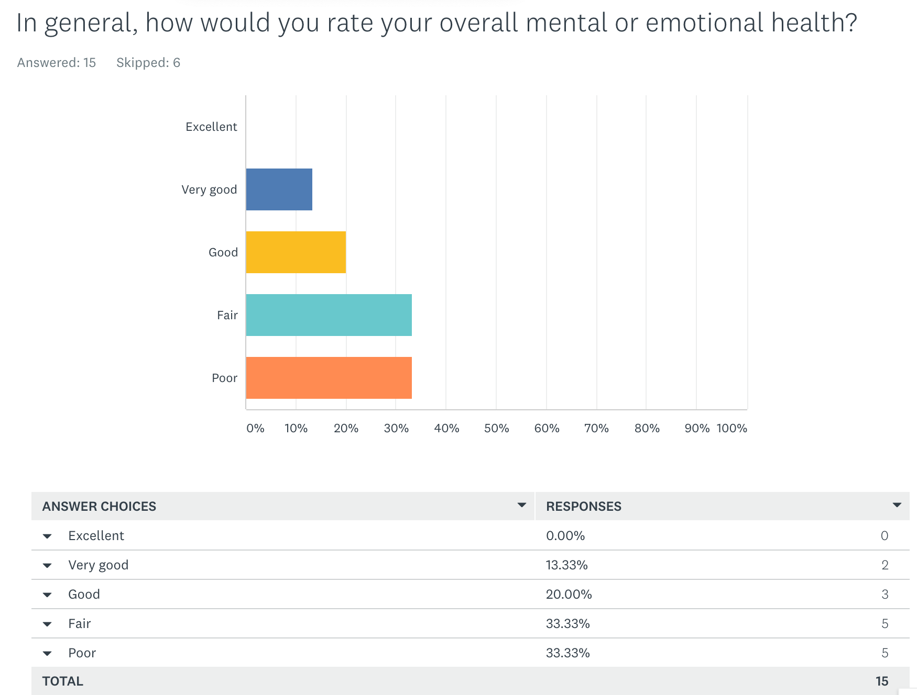

Slide 7
WHAT WOULD YOU CHANGE TO MAKE LIFE LESS STRESSFUL?
“The situation of the world/society's expectations.”
“Be well prepared”
“I would try to get rid of the things that cause me extra stress”
“My parents to be easier on me and my friends to show they cared more”
“People would be more considerate of other's feelings”
“Get rid of homework and try to do more self care”
“I would lift the quarantine for a day so I could say goodbye to my Grandma.”
“A lot of things”
“Drugs”
“Less emails from teachers”
“Less after school activities”
“Being w friendzzzzzzzzz”
“Not over think so much”
“Go back to normal life”

Slide 8
The 4HChangemakers is a group of Washtenaw County students (ages 13-18) whose goal is to raise student awareness and help educate their peers about what they can do (for themselves and others) regarding youth mental health in their communities. The students have hosted education/outreach events and trainings.
Teens use digital storytelling to increase awareness and destigmatize mental health through social media and (now virtual) public exhibits. Local and online experts share knowledge of tools to help tell stories: photography, graphic arts, videography, podcasting, interview techniques, meme making, and more. The group continues to explore innovative ways to humanize stories and share information with their peers.
This 4H Changemakers 2020 Digital Exhibit – STOMP OUT STIGMA -
is made possible thanks to generous funding from 4H, Microsoft, and University of Michigan Community Health Services.
Contact Washtenaw County 4H for more information about this and other teen mental health initiatives at (734) 222-3900 https://www.canr.msu.edu/washtenaw/washtenaw_county_4_h/

